Slide 1




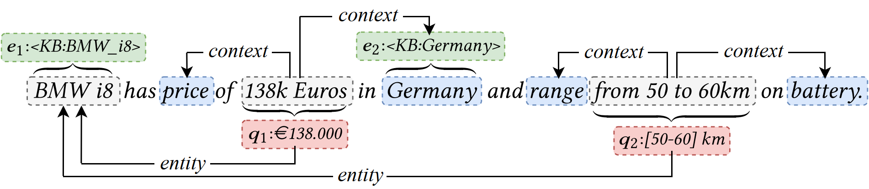
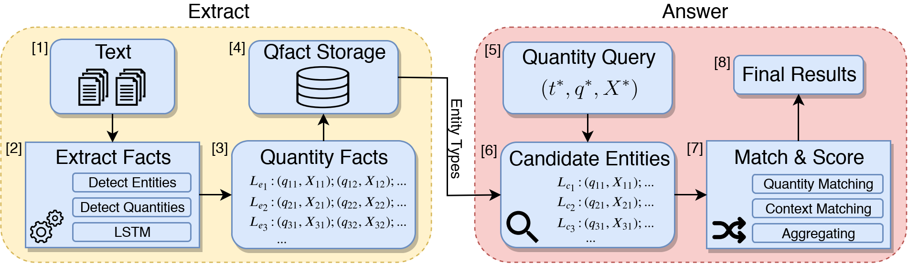
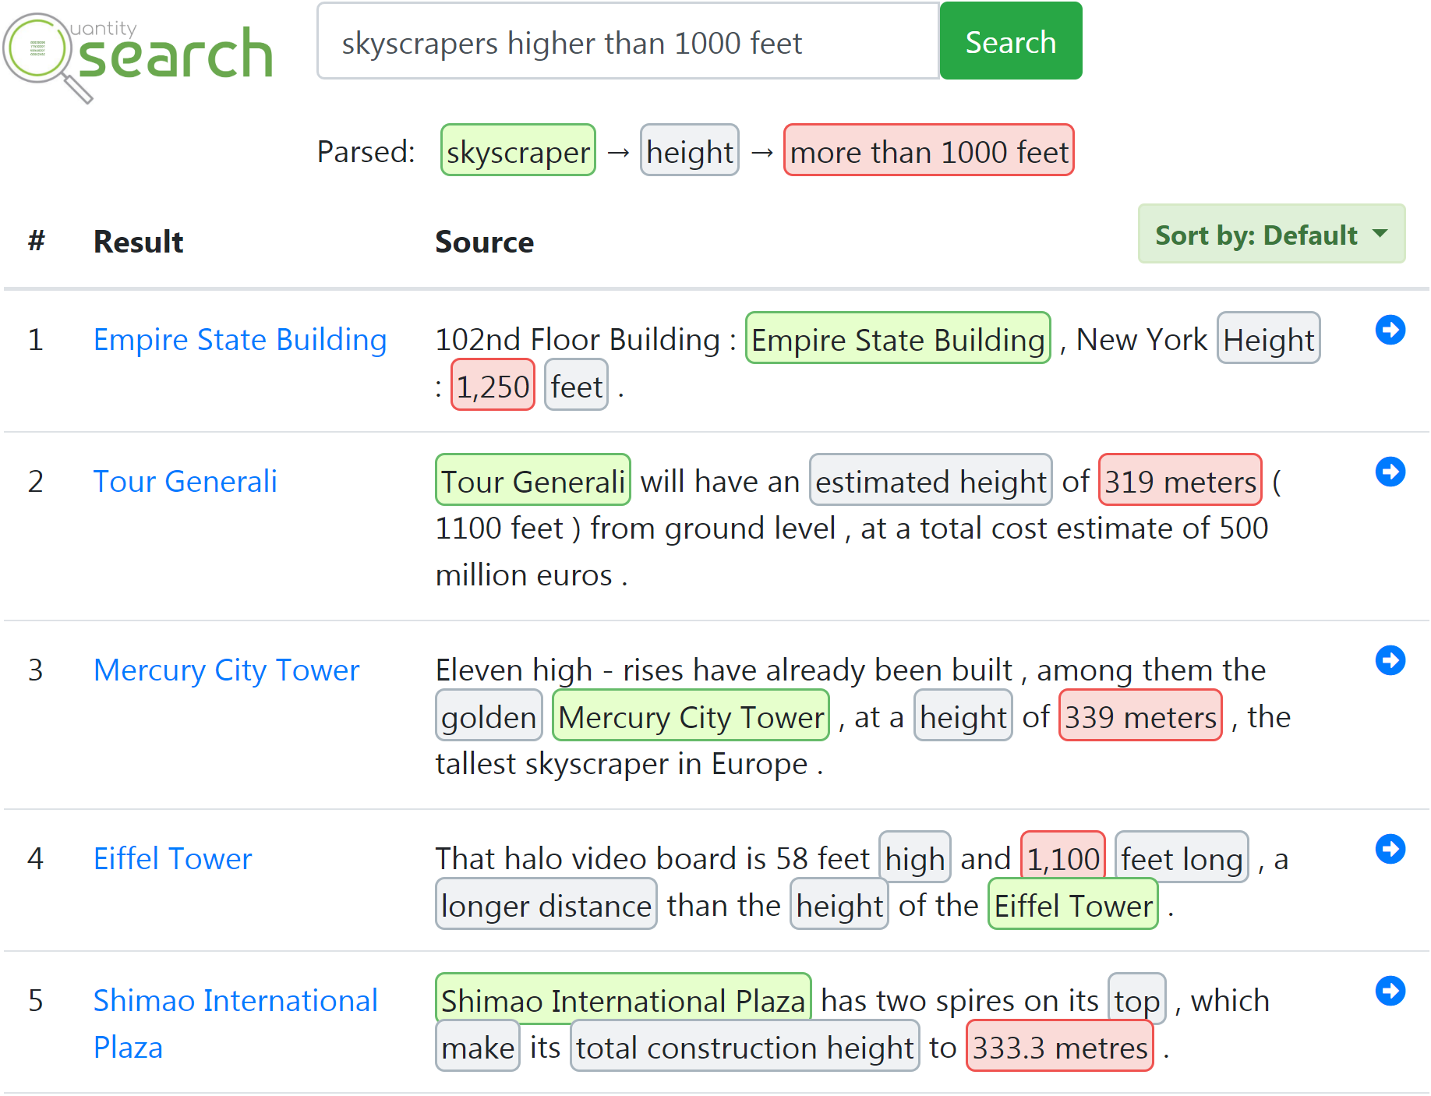
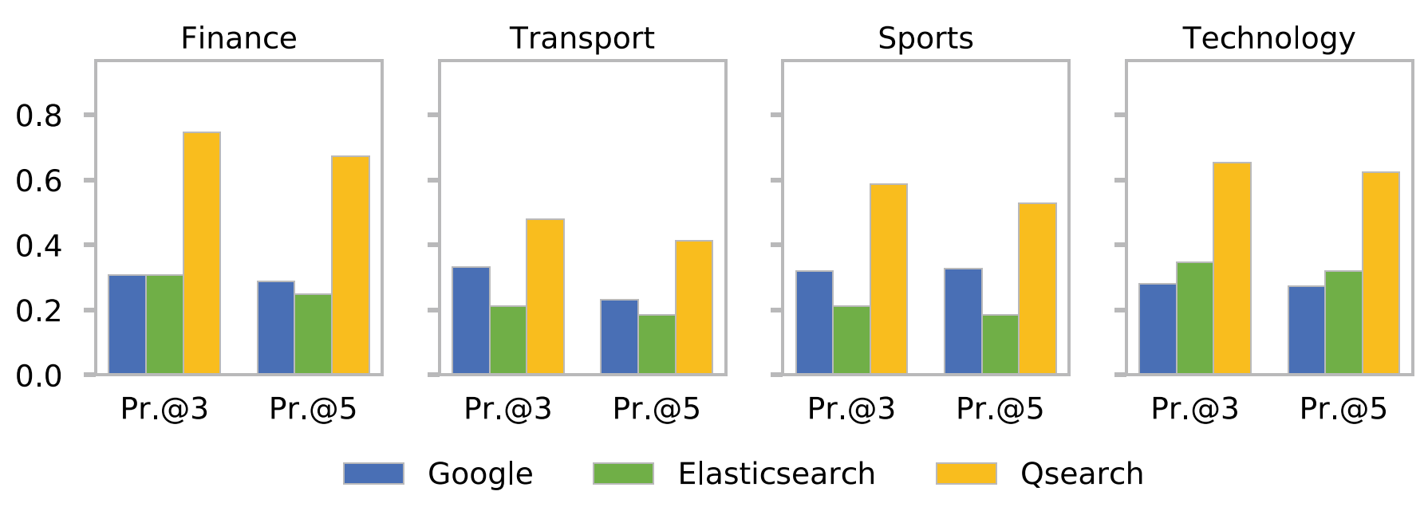
Entities with Quantities: Extraction, Search, and Ranking
Vinh Thinh Ho, Koninika Pal, Niko Kleer, Klaus Berberich, Gerhard Weikum
Motivation
Computational Framework
Quantity query:
What we expect Standard search engines give
Porsche 911 Carrera
$89,400
Chevrolet Camaro ZL1
$61,500
Ford Shelby GT350R
$67,135
etc.
Objective: Understanding of Quantities
Qquery
“cars with price less than $99k”
translate
= (t*; q*; X*)
t*:type
X*:context
q*:quantity
car
{ price }
< 99,000 $
type matching
context matching
quantity matching
BMW i3
{ cost, Germany }
34,950 €
e:entity
X:context
q:quantity
extract
Qfact
= (e; q; X)
Qfact Extraction & Qquery-Qfact Matching ^{[1]}
Qfact Extraction from Text
Three steps:
Entity Disambiguation ^{[2]}
Quantity Detection ^{[3]}
Neural-based Qfact Extraction ^{[1]}
For each quantity, find its linked entity and context
System Overview
Qsearch Interface
URL: https://qsearch.mpi-inf.mpg.de/
Evaluation
Datasets: STICS, New York Times, Wikipedia
Query Domains: Finance, Transport, Sports, Technology
Metrics: Precision@K, Hit@K, MRR
Baselines: Google, Elasticsearch
References
[1] V. T. Ho et al. Qsearch: Answering Quantity Queries from Text. ISWC 2019.
[2] J. Hoffart et al. Robust disambiguation of named entities in text. EMNLP 2011.
[3] S. Roy et al. Reasoning about quantities in natural language. TACL 2015.

